Slide 2
Rethink About Service Mesh Load Balancing
Zhonghu Xu, Huawei Cloud

Slide 3

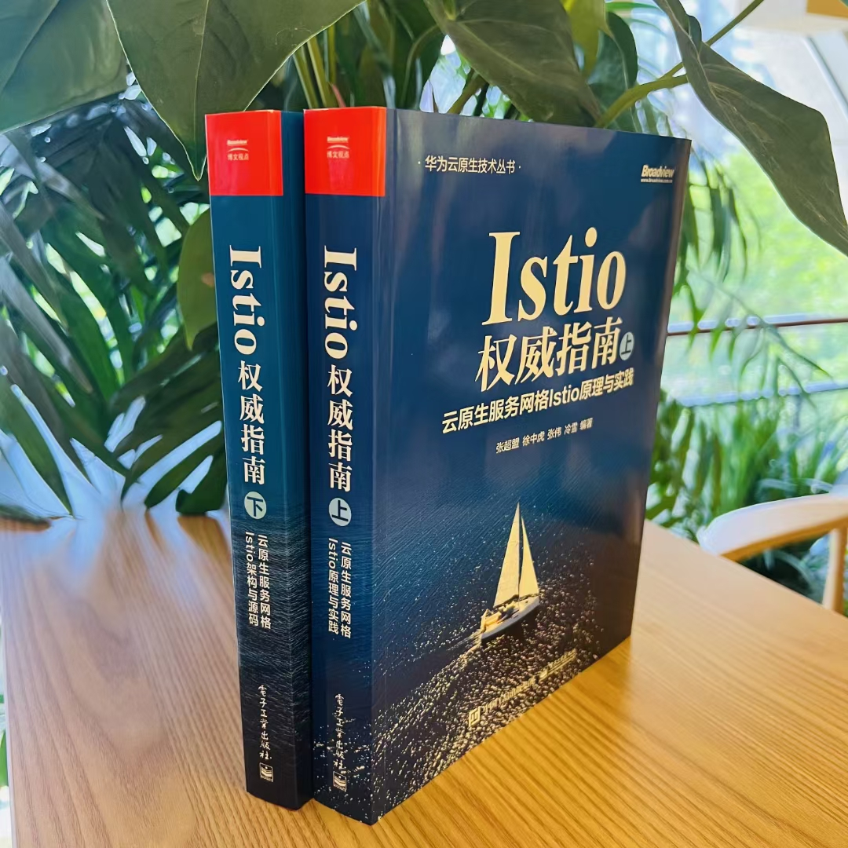
About Me
Istio steering committee member
Istio Maintainer
Volcano, Kurator Maintainer
Kubernetes member & core contributor
Google Open Source Peer Bonus Award
《云原生服务网格Istio》 & 《Istio权威指南》作者
Github：https://github.com/hzxuzhonghu
Github @hzxuzhonghu
Twitter @ZhonghuXu

Slide 4
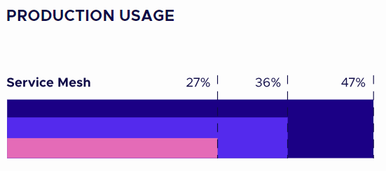
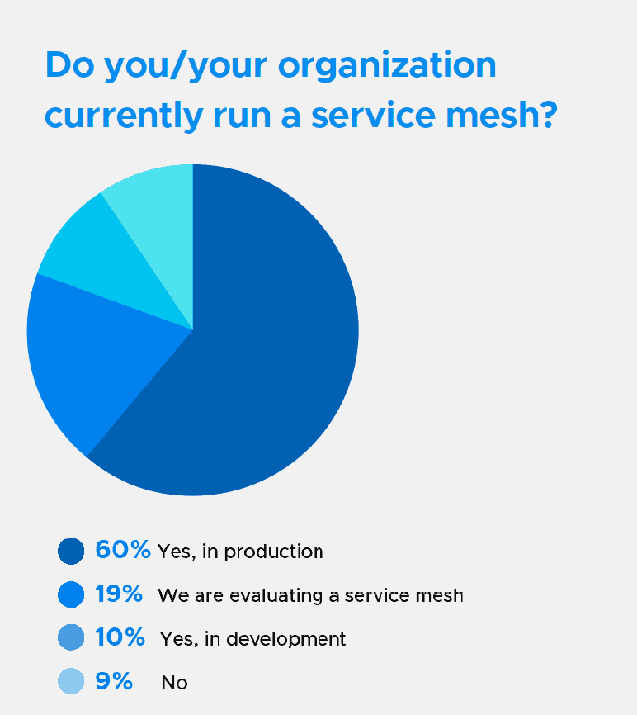

Service Mesh Production Usage Growth
Reference: CNCF 2022 Annual Survey
Reference: CNCF Service Mesh Micro Survey

Slide 5
Most Concerned Features
Security – for example mTLS
79%
Which of the
following features
and capabilities are
driving your adoption
of service mesh?
Obsevability – for example, golden metrics
78%
Traffic management – for example, blue-green deploys
62%
Reliability – for example request retries
56%

Slide 6
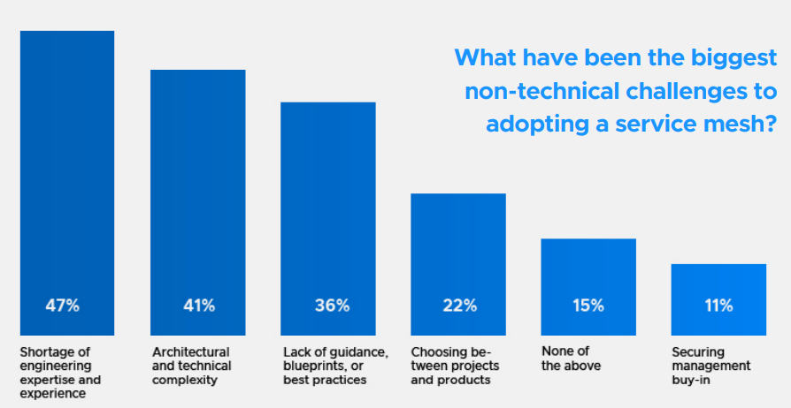
Biggest Challenges to Adopting Service Mesh

Slide 7
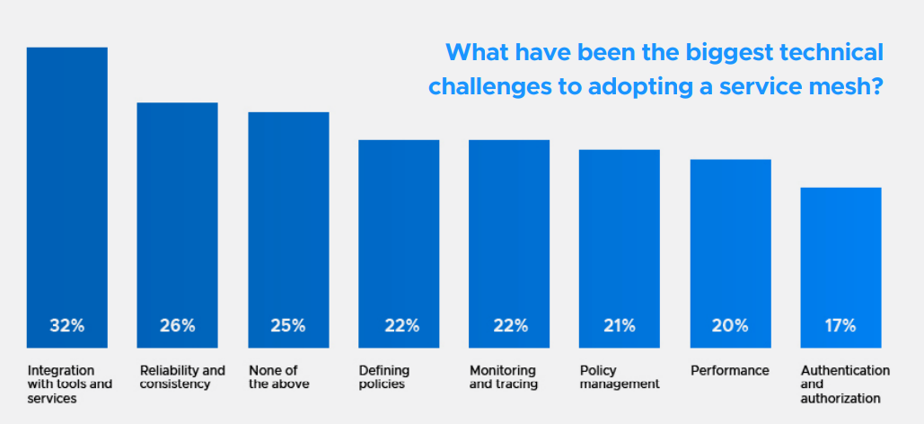
Biggest Challenges to Adopting Service Mesh

Slide 8
Load Balancing Intro
Load balancing is a technique used to distribute incoming traffic across services.
Harware & Sofware Load Balancer
Improved responsiveness
Client 1
Client 2
Client 3
Increased reliability
Load balancer
(Envoy, Nginx, HAProxy)
Server 1
Server 2
Server3
Better scalability
……

Slide 9
Istio Supported Load Balancing Algorithms
Basic:
Least Request, current default behavior
Random, randomly select a endpoint
Round Robin, Weighted RR. Previously default
Consistent Hash: Ring Hash, Maglev
Advanced:
Locality aware load balancing
Prioritized load balancing, fail over
Slow Start, progressively increase amount of traffic to newly added upstream endpoint
Basic and Advanced can work together, like Ring Hash with Priority.
In this case, each priority level endpoints is chosen by hash.

Slide 10
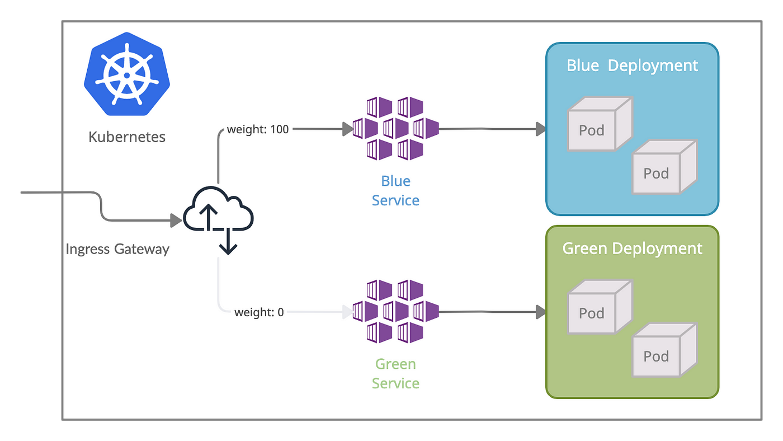
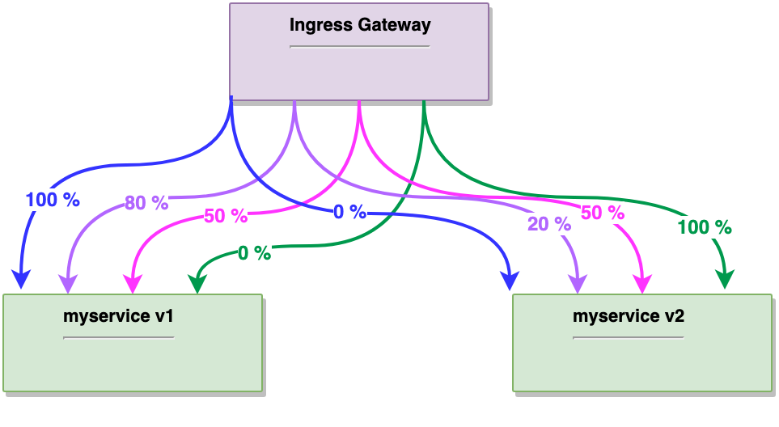
Istio Supported Routing Feature
Application aware
Dynamic Route
Supported HTTP1.1, HTTP2, gRPC, HTTPS, Redis, Dubbo protocols
apiVersion: networking.istio.io/v1alpha3 kind: VirtualService metadata: name: reviews spec: hosts: - reviews http: - match: - headers: end-user: exact: jason route: - destination: host: reviews subset: v2 - route: - destination: host: reviews subset: v1
apiVersion: networking.istio.io/v1alpha3 kind: VirtualService metadata: name: reviews spec: hosts: - reviews http: - route: - destination: host: reviews subset: v1 weight: 80 - destination: host: reviews subset: v2 weight: 20
Blue-Green Deploy
Grey Release & Canary Release

Slide 11
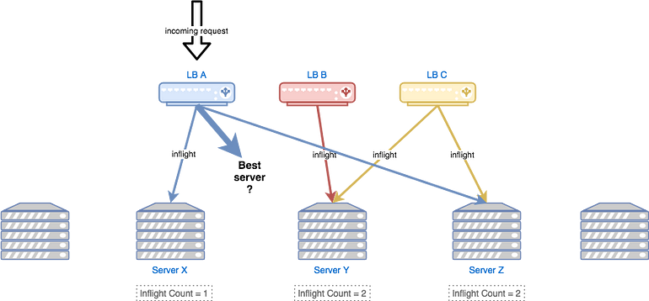
Are you Satisfied With Istio LB Features?
Yeah! It is rich and meet most usages scenarios.
But…
When the machine is slow, for example hardware failure, the endpoints resides in could be very slow too.
Least request algorithm caveats
Herding Problem as traffic is balanced based on the statistics from load balancer’s own view.
Does not take into account of server capacity/load, may lead to server overwhelmed
Does not take into account of request characteristics, such as request size, request type, request priority, request handling latency.
3. While istio support weighted subset cluster, but does not support subset fallback.

Slide 12
Rethinking Istio Load Balancing
Guiding principles
Apply learnings from others, build on top of other implementations: choice-of-2 and probation algorithms
Any server not overloaded
Handle requests with least latency, algorithm executing time, network latency, plus server processing time
Avoid client-side complex configuration and manual tuning
Reference: Rethinking Netflix’s Edge Load Balancing
Notes:
choice-of-2 and probation algorithms
随机选择两台机器，选择负载较轻的服务器转发请求
Probation alporithm： 每个后端服务器都有一个成功请求处理数量的法制，如果请求失败，server进入probation（试用期）
在试用期内，server只接受很少的请求，试用期内请求继续处理成功，退出试用期。

Slide 13
Lessons Learned
Load balancing approaches:
Adaptive tuning: combine client viewed request latency and server’s load as input of lb algorithm
Combine join-the-shortest-queue (least request/least connection) with choice-of-2 algorithm to choose between servers to prevent herd
Probation mechanism to reduce failure and improve resilience
Reference: Rethinking Netflix’s Edge Load Balancing

Slide 14
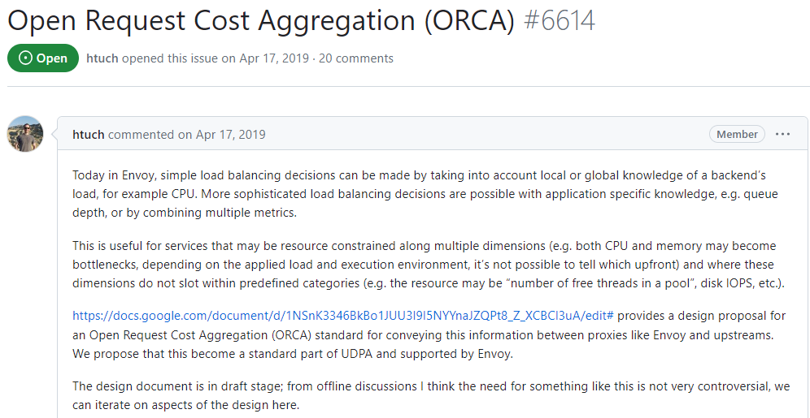
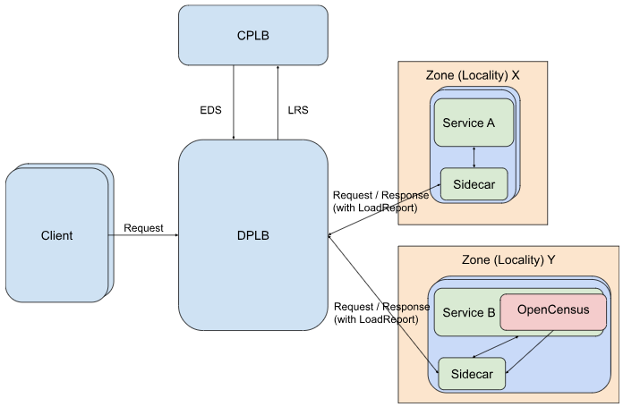
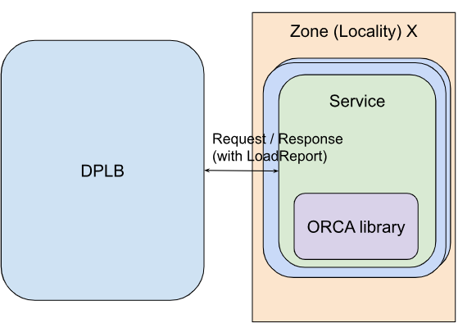
Server Utilization Report
In-band reporting, via HTTP response header `x-endpoint-load-metrics`
Out-of-band (OOB) reporting
Reference: OCRA Design

Slide 15
Conclusion
Istio load balancing is underlying based on envoy, but extend with high level capability, especially for Kubernets env. Like metadata based prioritized balancing
Load balancing is not the bottlenecks of istio, while resource cost and operation complexity are.
OCRA is not implemented yet, in Istio we can help push it land down.
We can make full use of existing algorithm to support more higher-order capabilities, such as headless service persistent session and subsets fallback.

Slide 16

How can you contact me
Github: @hzxuzhonghu
Istio Slack: @hzxuzhonghu
WeChat: @zhhxu2011

